Slide 1

Computer Organization and Assembly Language (CS2523)
Department of Computer Science,
Capital University of Science and Technology, Islamabad
Fall Semester, 2022

Slide 2
Lecture Outlines
Microprocessor Systems (Intro & History)
Evolution of Microprocessors
Moore’s Law
Introduction to Computer Organization
Introduction to Assembly – Translating Languages

Slide 3
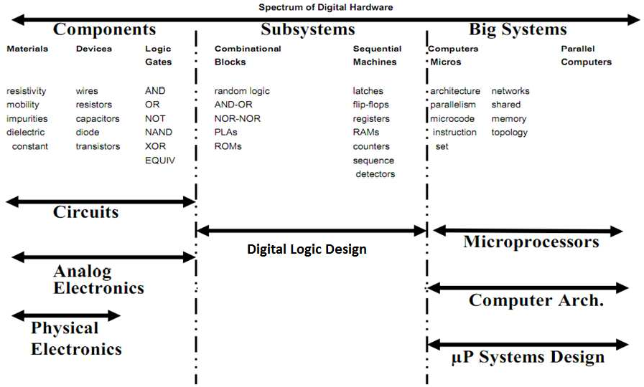
Where this course fits in

Slide 4


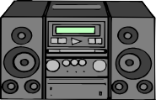

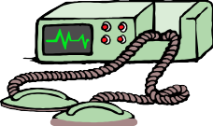

A Short List of Microprocessor Systems
Digital Computers
Digital Camera
Digital television
Digital audio & video players
Cell phones
Modern radios
Digital calculators
Medical equipments
Communication Equipments
Control systems

Slide 5
Main Objectives of Course
Describe the function of each unit inside the microprocessor (Architectural details).
Understand and write code in the Intel Assembly language for the 80xxx family.

Slide 6
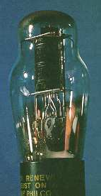
Historical Background
First Generation
No mechanical components anymore
Vacuum Tubes
Principle
Basic: Triode
Grid voltage (anode) to simply turn a current On / Off (Half wave rectification)
1946: ENIAC machine
Electronic Numerical Integrator And Computer

Slide 7
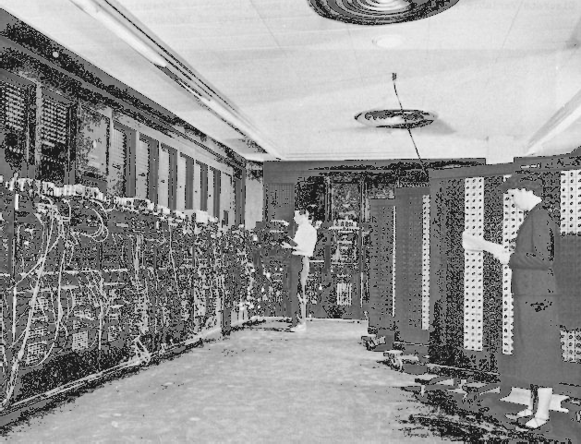

Historical Background
ENIAC$→1946$

Slide 8

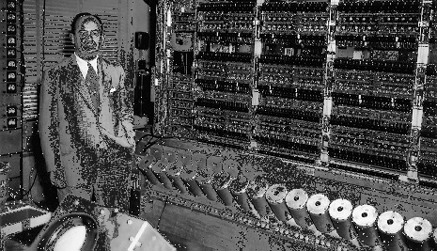
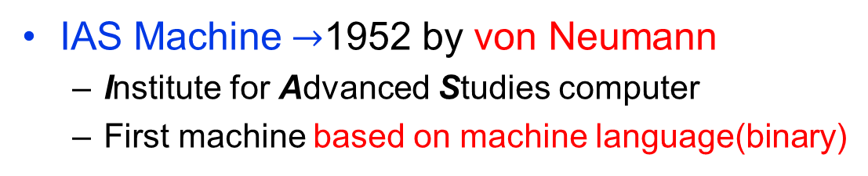
Historical Background
IAS Machine$→$1952 by von Neumann
Institute for Advanced Studies computer
First machine based on machine language(binary)

Slide 9
Historical Background
IAS Machine
Dominant architecture in today’s systems
Used in all popular systems / chips
Modifications/Up-gradations
CPU (Central Processing Unit)
New memory paths between memory and I/O Direct Memory Access (DMA)
New incorporated Ideas
Multiple arithmetic units / Multiple CPUs (Multicore)
Parallel processing

Slide 10
Historical Background
Transistors replaced Vacuum tubes in 1948
Smaller, more power efficient
Still large machines
Evolution of Integrated Circuits(IC’s) in 1958
Many transistors packed on one die
High density & reliability, low power

Slide 11
Historical Background
Gen. | Dates | Technology | Speed | Time/Ops
1 | 1946-1957 | Vacuum tube | 40 KHz | 25 µs
2 | 1958-1964 | Transistor | 200 KHz | 5 µs
3 | 1965-1971 | Small and medium integrated circuits | 1 MHz | 1 µs
4 | 1972-1977 | Large scale integration | 10 MHz | 100 ns
5 | 1978- | Very large scale integration | 100 MHz | 10 ns

Slide 12
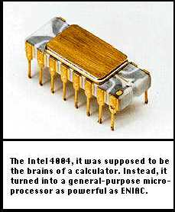
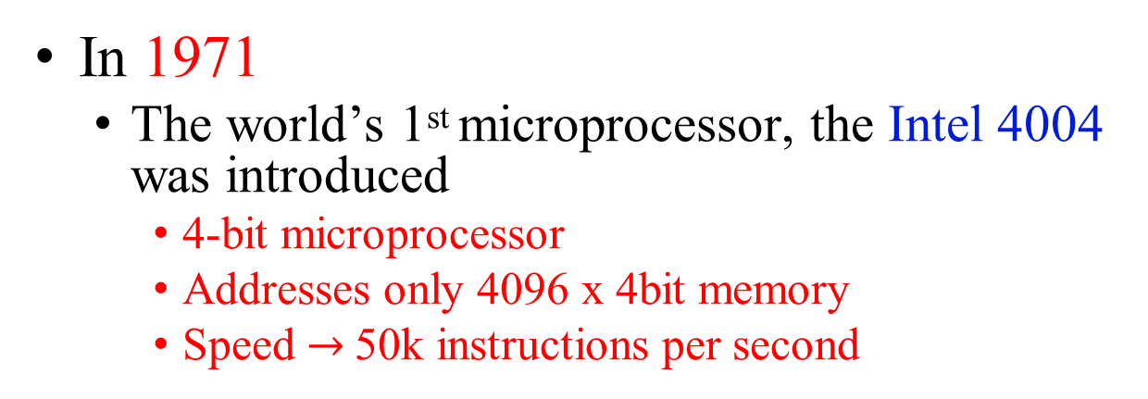
Microprocessors Age -- Intel
In 1971
The world’s 1st microprocessor, the Intel 4004 was introduced
4-bit microprocessor
Addresses only 4096 x 4bit memory
Speed $→$50k instructions per second

Slide 13
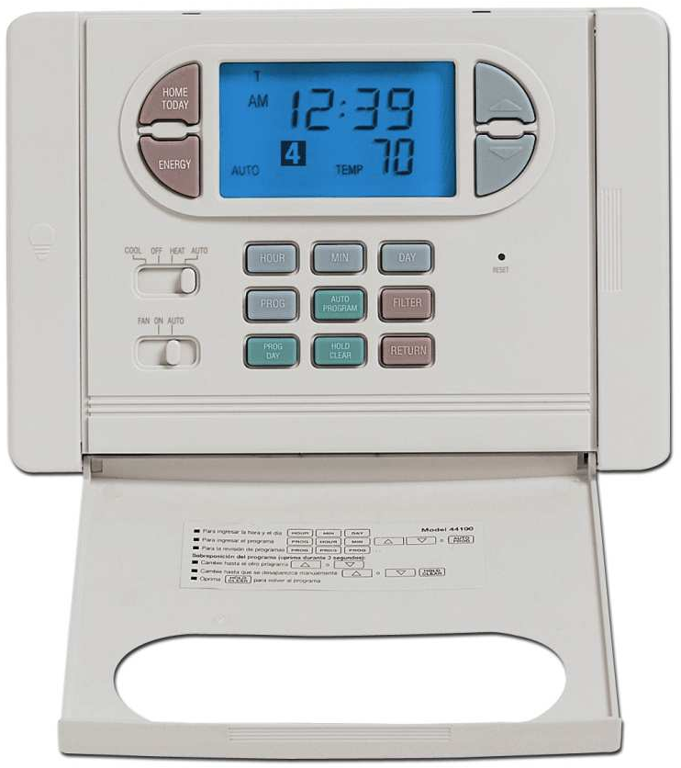
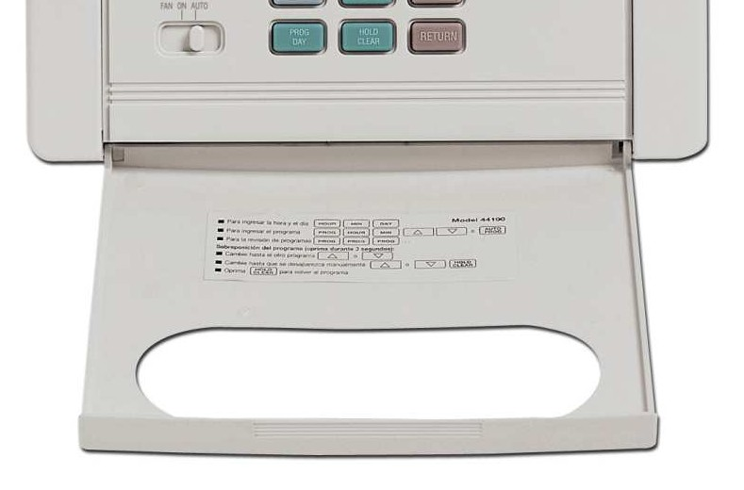
Example: A thermostat
4-bit microprocessor
A thermostat is a component which senses the temperature of a physical system and performs actions so that the system's temperature is maintained near a desired set point.
Notes:
A thermostat is a component which senses the temperature of a physical system and performs actions so that the system's temperature is maintained near a desired set point.

Slide 14
Microprocessors Age -- Intel
Later in 1971
8008 was released
8-bit version of the 4004
It addressed a 16K byte memory
In 1973
8080 was introduced
limitations of the speed and instruction set of 8008 were addressed and improved
It addressed a 64K bytes memory

Slide 15
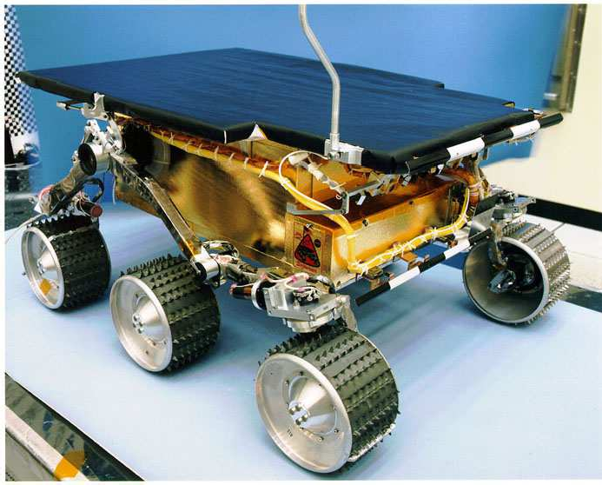
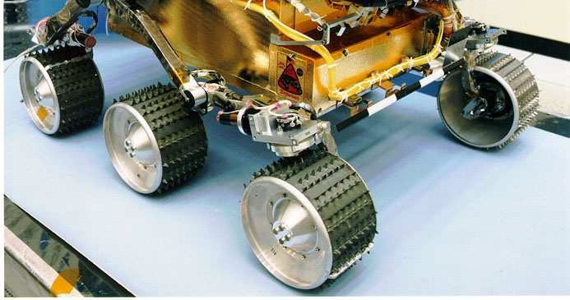
Example: NASA's Mars Sojourner Rover
8-bit microprocessor
Intel’s 80C85
Notes:
Sojourner is the Mars Pathfinder robotic Mars rover that landed on July 4, 1997 in the Ares Vallis region, and explored Mars for around three months. It has front and rear cameras and hardware to conduct several scientific experiments.

Slide 16
Example: NASA's Mars Sojourner Rover
8-bit microprocessor
Intel’s 80C85
Sojourner is the Mars Pathfinder robotic Mars rover that landed on July 4, 1997 in the Ares Vallis region, and explored Mars for around three months. It has front and rear cameras and hardware to conduct several scientific experiments.

Slide 17
Microprocessors Age -- Intel
In 1978-79
8086 and 8088 modern µp’s (Microprocessors) were introduced.
16-bit microprocessors (8 bit external data bus for 8088)
Addresses 1M byte of memory.
2.5 million instructions per second
Multiply and divide instructions included
International Business Machines(IBM) decided to use the 8088 in its first ever PC in 1981 making it very popular

Slide 18
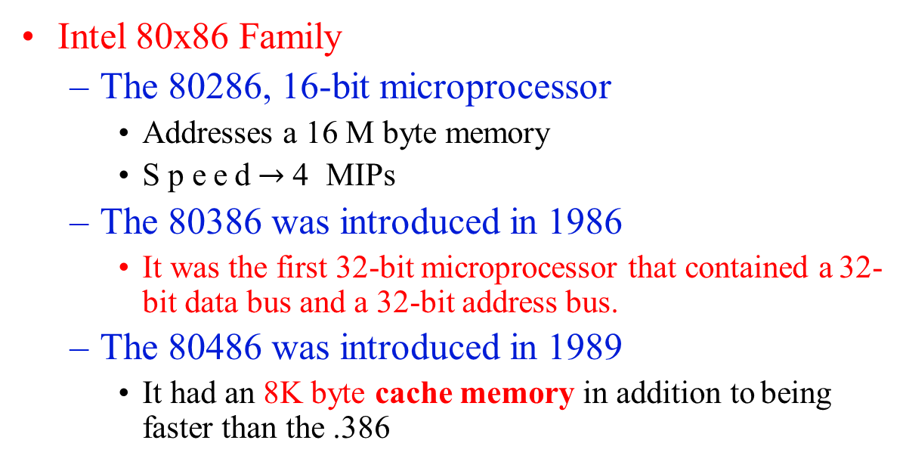
Microprocessors Age -- Intel
Intel 80x86 Family
The 80286, 16-bit microprocessor
Addresses a 16 M byte memory
Speed$→$4 MIPs
The 80386 was introduced in 1986
It was the first 32-bit microprocessor that contained a 32- bit data bus and a 32-bit address bus.
The 80486 was introduced in 1989
It had an 8K byte cache memory in addition to being faster than the .386
Million instructions per second (MIPS) is an older, obsolete measure of a computer's speed and power, MIPS measures roughly the number of machine instructions that a computer can execute in one second.
Notes:
Million instructions per second (MIPS) is an older, obsolete measure of a computer's speed and power, MIPS measures roughly the number of machine instructions that a computer can execute in one second.

Slide 19
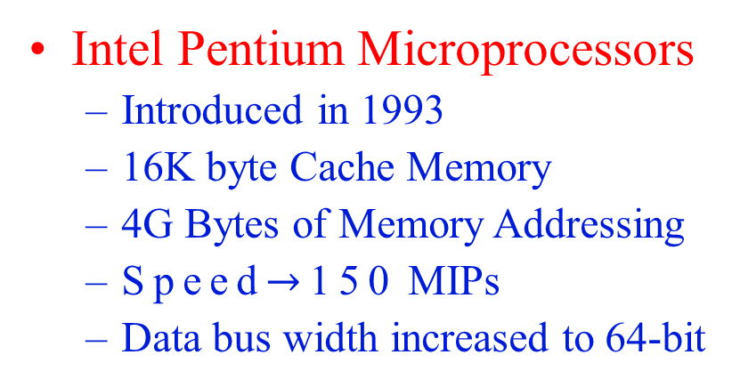
Microprocessors Age -- Intel
Intel Pentium Microprocessors
Introduced in 1993
16K byte Cache Memory
4G Bytes of Memory Addressing
Speed$→$150 MIPs
Data bus width increased to 64-bit
Later Pentium versions are up-gradations of above specifications in terms of Speed, Memory(levels of caches) and more complex instruction set

Slide 20
Microprocessors Age -- Intel
Intel Pentium Microprocessors
Introduced in 1993
16K byte Cache Memory
4G Bytes of Memory Addressing
Speed$→$150 MIPs
Data bus width increased to 64-bit
Later Pentium versions are up-gradations of above specifications in terms of Speed, Memory(levels of caches) and more complex instruction set

Slide 21
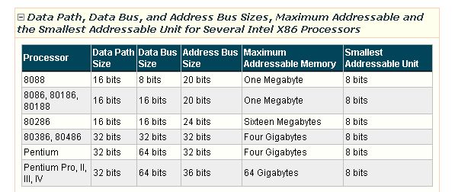

Slide 22
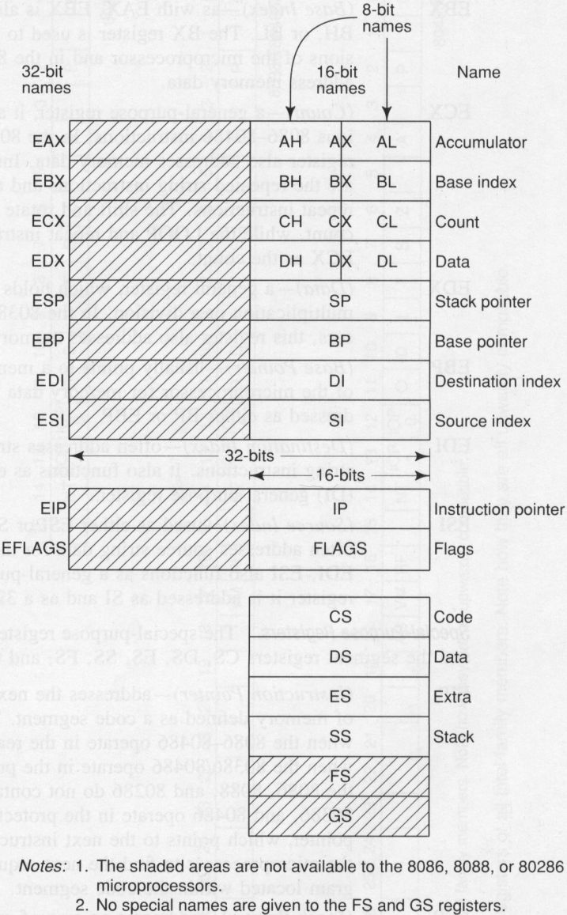

Slide 23
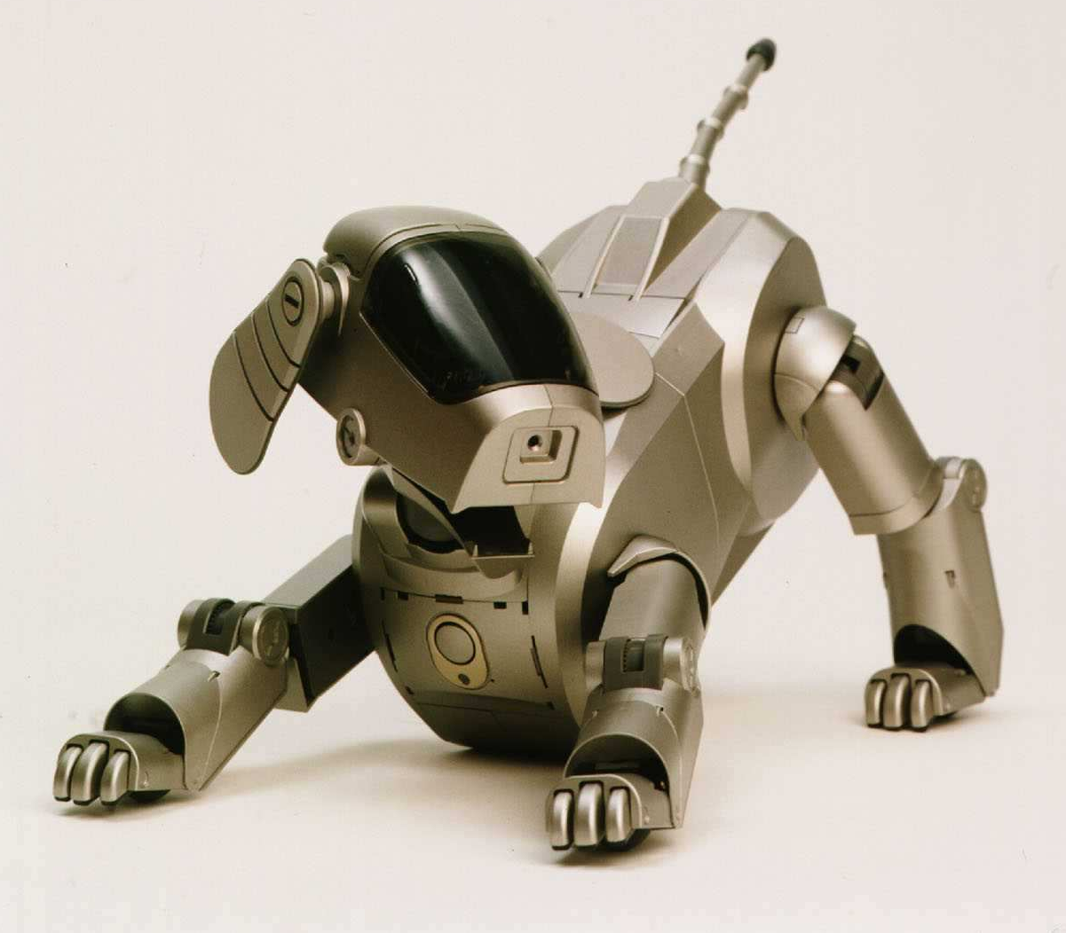
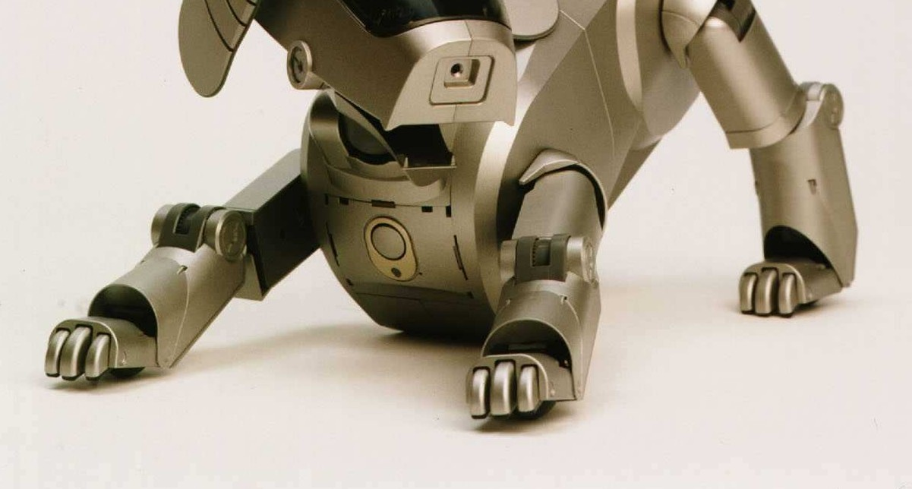
Example: Sony Aibo ERS-110 Robotic Dog
Microprocessor: 64- bit MIPS RISC
What they have in common: They sense the environment (input signals), decide on (compute) their actions (responses) in real time.
RISC (reduced instruction set computer) is a microprocessor that is designed to perform a smaller number of types of computer instructions so that it can operate at a higher speed (perform more millions of instructions per second, or MIPS).
Notes:
RISC (reduced instruction set computer) is a microprocessor that is designed to perform a smaller number of types of computer instructions so that it can operate at a higher speed (perform more millions of instructions per second, or MIPS).

Slide 24
Moore’s Law
Gorden Moore (Co-founder of Intel) observed in 1965 that the number of transistors that could be put on a single chip was doubling every year and predicted that this pace would continue
He later revised the time to 18 months (in 1975) and this rate has sustained since

Slide 25
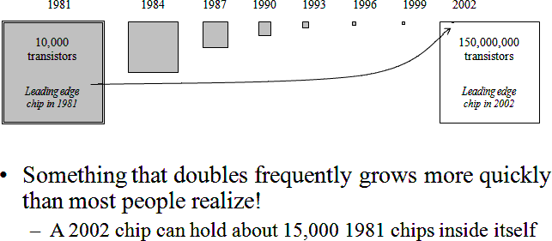
Moore’s Law

Slide 26
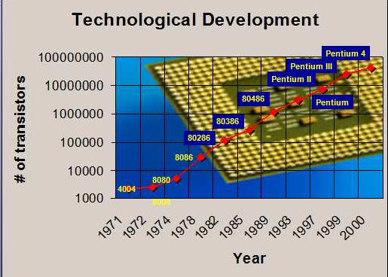
Moore’s Law

Slide 27
Computer Organization
This course is design to understand the basics organization of computers
Address bus - carries memory addresses from the processor to other components such as primary storage and input/output devices. The address bus is unidirectional .

Slide 28
Computer Organization
Data bus - carries the data between the processor and other components. The data bus is bidirectional .
Control bus - carries control signals from the processor to other components. The control bus also carries the clock's pulses. The control bus is unidirectional.

Slide 29
Basic Computer Organization
Processor
Memory
I/O

Slide 30
Basic Computer Organization
Processor
Operation
Memory Data

Slide 31
Basic Computer Organization
Processor
Operation
Memory Data

Slide 32
Basic Computer Organization
Processor
Address Bus
Memory
Data Bus
Control Bus

Slide 33
Dimensions of Memory
Horizontal Dimensions = Width of Memory Cell
00000000
Vertical Dimensions
=
Size of
Memory
00000001
Binary
Addresses
Of
Memory
Cells
00100011
00100100
00100101

Slide 34
Basic Computer Organization
Processor
Memory
Control Bus

Slide 35
Translating Languages
English: Display the sum of A times B plus C.
C++: cout << (A * B + C);
Intel Machine Language: A1 00000000
F7 25 00000004
03 05 00000008
E8 00500000
Assembly Language: mov eax,A
mul B add eax,C
call WriteInt

Slide 36
Translating Languages
WriteInt PROC
Writes a signed 32-bit decimal number to standard output in decimal format with a leading sign and no leading zeros.
Call args: EAX = signed number to write
Return arg: None
Example:
mov eax,216543
call WriteInt
Output: +216543
NOTES: To write an unsigned integer, use the WriteDec procedure.
To write in hexadecimal, use the WriteHex procedure.
To write in binary, use the WriteBin procedure.
Use the mShow macro to display the contents of an 8-, 16-, or 32-bit variable or register in any combination of hexadecimal, signed decimal, unsigned decimal, or binary formats.
The FUNCTION directive marks the start of a function. PROC is a synonym for FUNCTION.

